Slide 1

Lecture 5: Form a Project Group Meeting
Dr. Tsung-Wei Huang
Department of Electrical and Computer Engineering
University of Utah, Salt Lake City, UT
Notes:
Hello everyone, today we are going to help you go through the team forming process.

Slide 2
Group Meeting
Every one is assigned to a breakout room
Zoom: https://utah.zoom.us/j/2468214418
Each breakout room has 5 people
Check out your assignment below
https://docs.google.com/spreadsheets/d/1JfWZkEyoXdVLtHkiwOqk24G7WVhLWMCP113cSe9fgsQ/edit#gid=2013796755
Each group is given 40 minutes to discuss:
Project name
Project objective
Challenge and Risk? Mitigation Plan?
Who to present
Fill in your discussion in the excel sheet

Slide 3
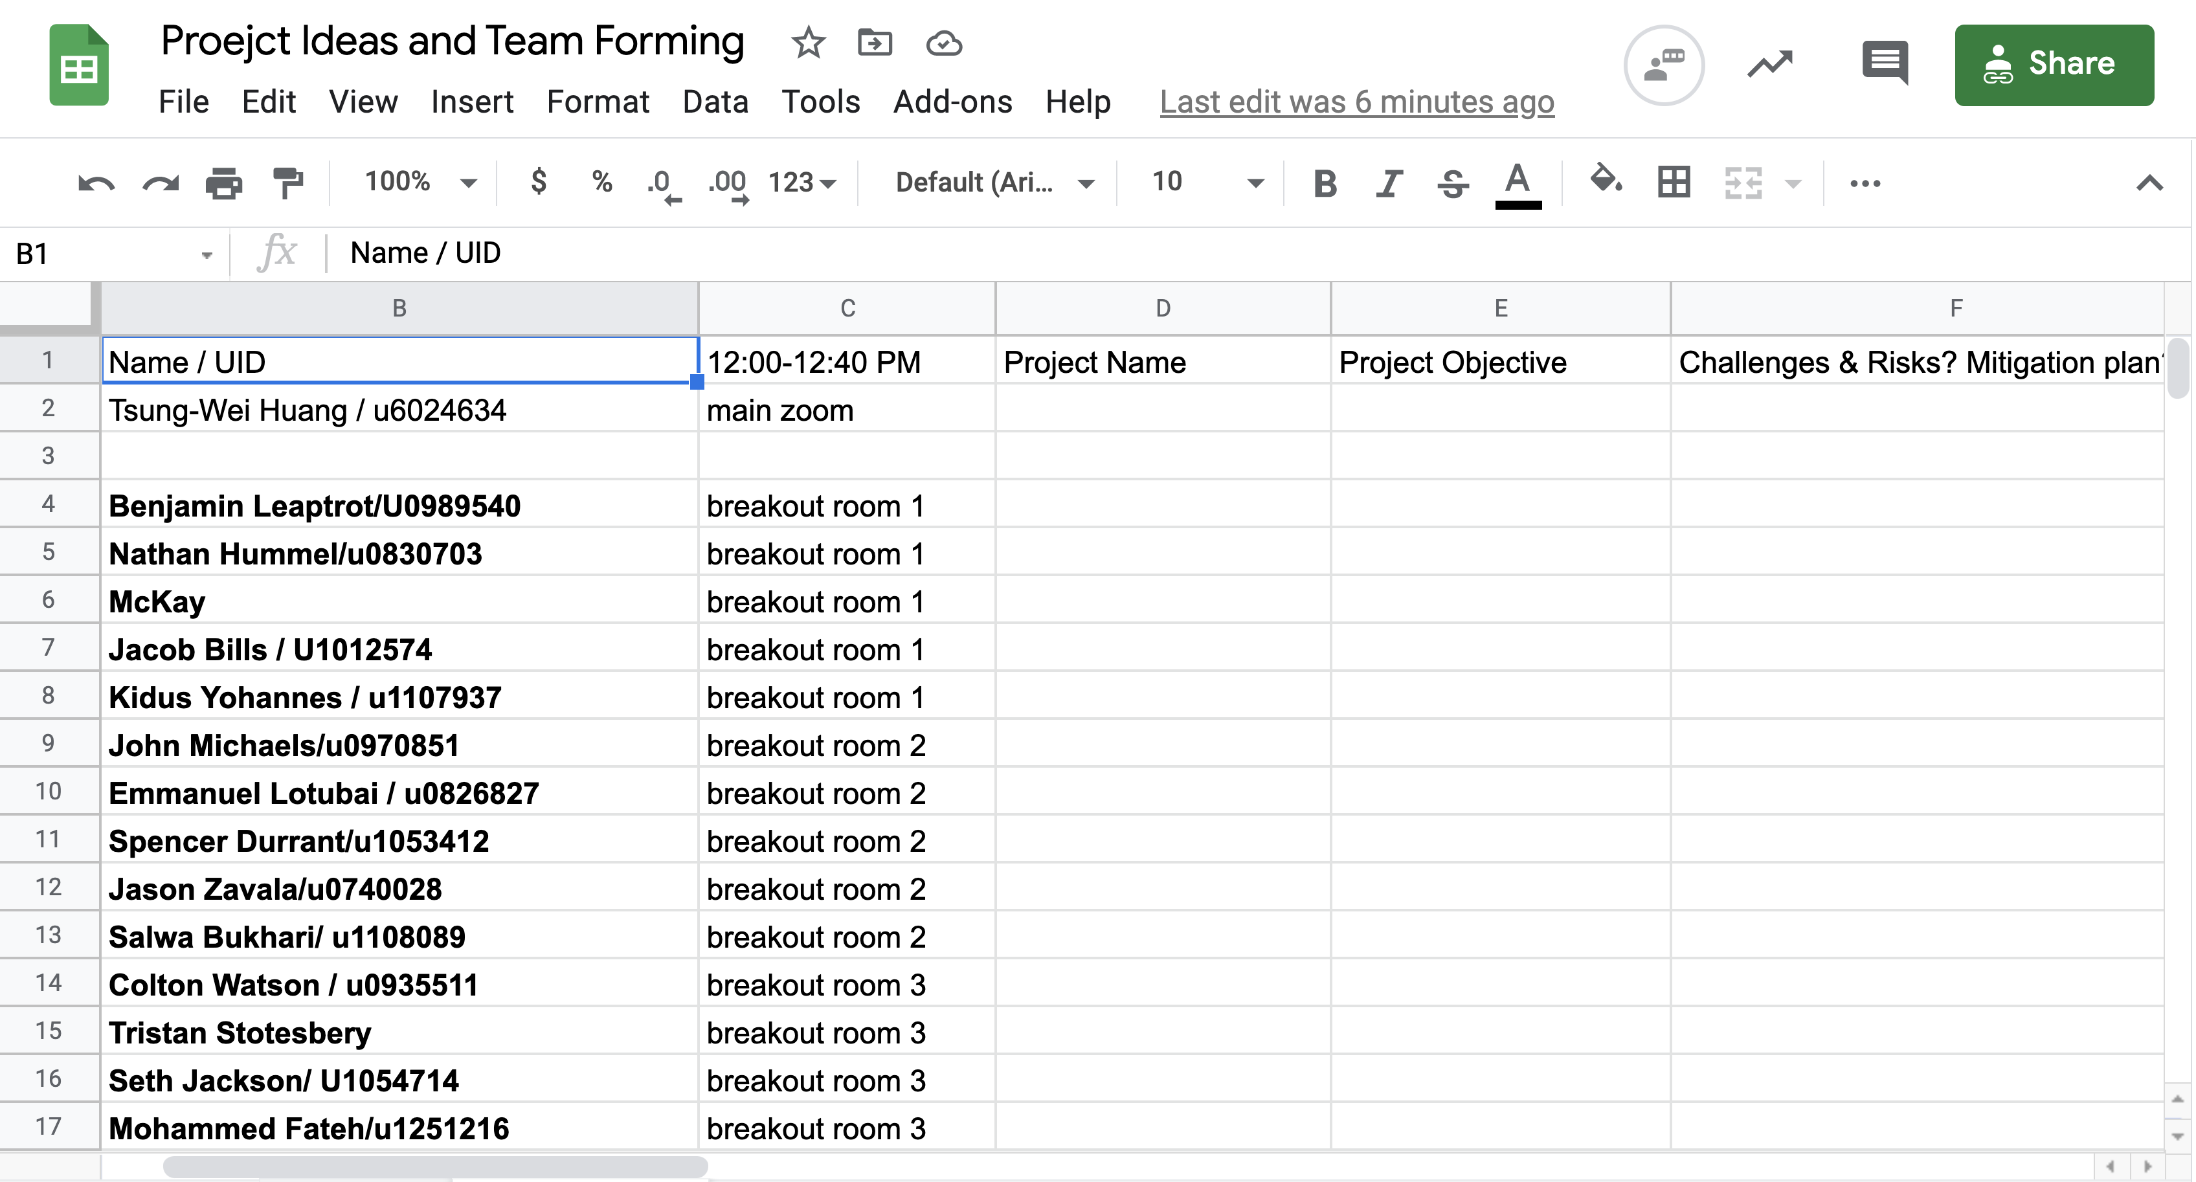
A Glance

Slide 4
Things to Know!
Consider this as a project meeting with tech details
It does not matter if you already have a team
Try to come up with a suitable idea per group
Discuss the potential challenges of the project
Discuss the mitigation plan for the risks
Everyone has a chance to present!
We will repeat this group meeting in the next 2 weeks
We will rotate the assignment
Collaboration, Collaboration, Collaboration, Collaboration, Collaboration, Collaboration, Collaboration, Collaboration, …

Slide 5
Attention!
You don’t need to finalize the project idea!
This is a lesson to learn:
Hear others’ voice and under their background
Hear others’ opinions/feedback about your idea
Sit down and discuss the challenge of a project
What is it?
Why do we need it?
What are the challenge we need to overcome?
Everyone’s opinion matters!

Slide 6

Learn to Collaborate

Slide 7
To Get You Off the Ground
Step 1: Start with a gentle introduction
Step 2: Everyone talks about his/her idea
Step 3: Discuss why people care about the idea
Step 4: Come down to one project idea to present
Step 5: Fill in the cells in excel sheet per group
Step 6: Select one person to present
Again, the idea doesn’t need to be finalized! It doesn’t matter if you already have a team or a project to do. The process is to help everyone go through a “mock technical meeting” process and learn how to incubate a project starting from scratch.
These experiences will be bring significant values to your senior project design!

Slide 8
Assignment #2 Due Today 11:59 PM!
Resume (with link to your website)
Virtual career fair is coming on Feb 8 and Feb 9
https://careers.utah.edu/events/
Submit your resume
Go find a summer internship
Go gain some “real” experience

